Slide 1
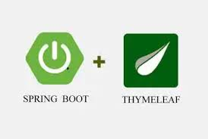
Live Virtual Class on Unit-13 and Unit-14
Spring Boot View & Spring Boot AOP : Logging
Rahul Kumar Dixit

Slide 2

Agenda
Spring MVC Overview
Spring MVC Diagram
Spring MVC Component
What is Thyme Leaf?
Need of Thyme Leaf
Features of Thyme Leaf and Template Types
Spring Boot AOP
Different Types of Advices
Logging –Console Log Output and File Log Output

Slide 3
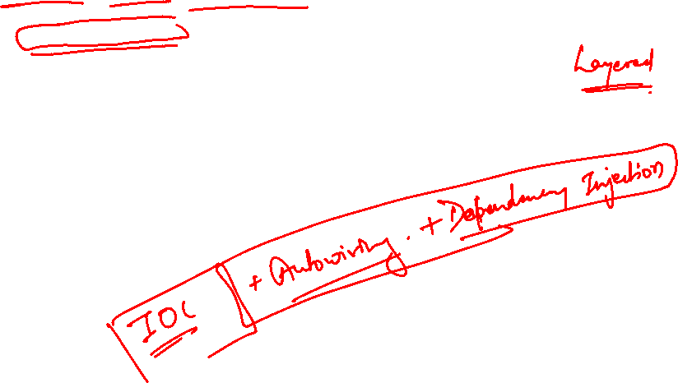
Spring MVC Overview
Based on the Model view Controller design pattern.
Built on top of spring core.
Framework for building web application in java.

Slide 4
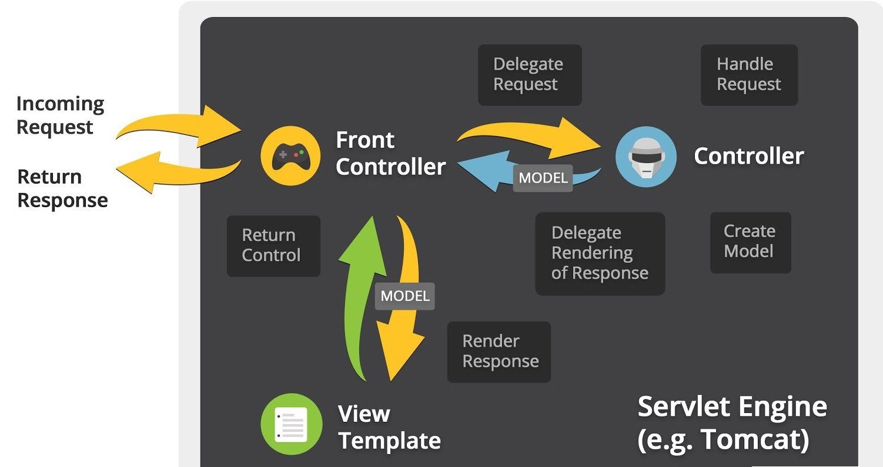

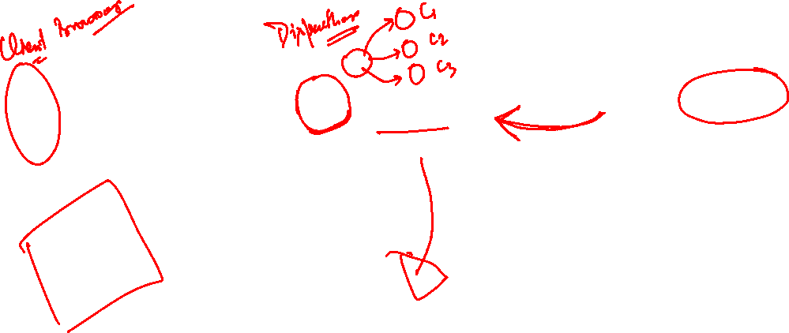
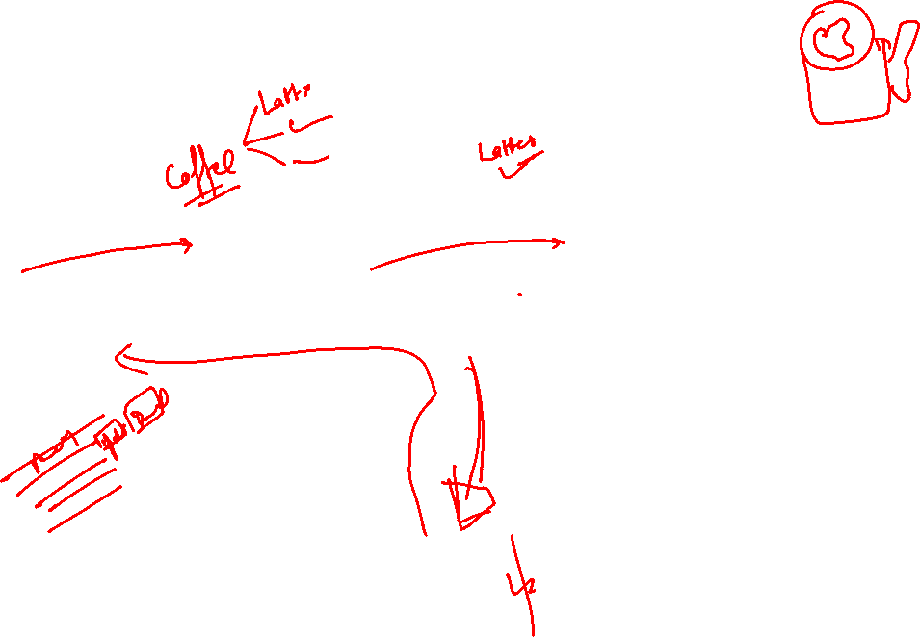
MVC Architecture and View Layer (Diagram)

Slide 5
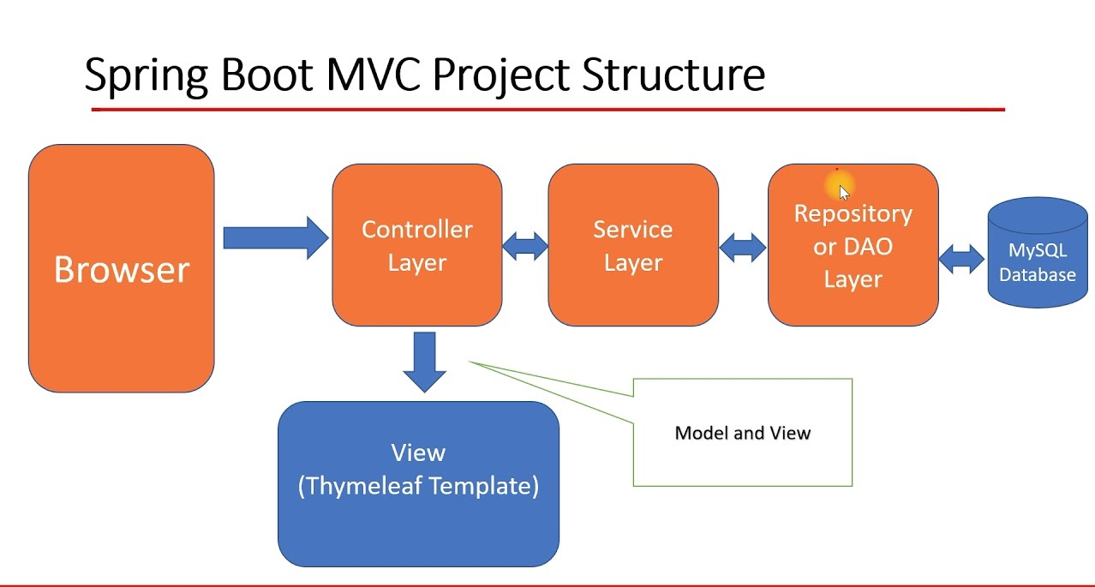
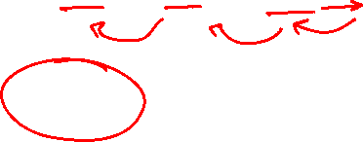

Working Process of MVC Architecture and View Layer
All the incoming requests are intercepted by the DispatcherServlet that works as the front controller.
The DispatcherServlet then gets an entry of handler mapping from the XML file and forwards the request to the controller.
The object of ModelAndView is returned by the controller.
The DispatcherServlet checks the entry of the view resolver in the XML file and invokes the appropriate view component.

Slide 6
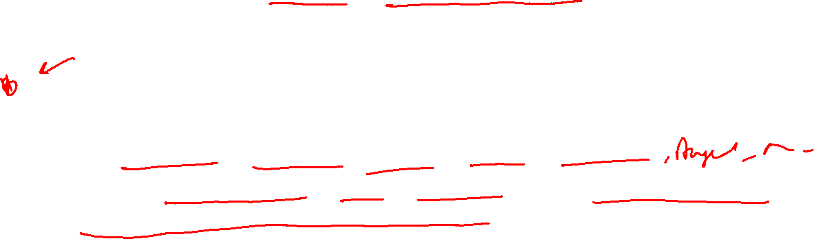
Spring MVC Components
Front Controller : Known as Dispatcher Servlet , part of spring framework
Controller : Handles the request, sends to appropriate view page , place data in model.
View Template : Displays Data, spring supports many view template like JSP+JSTL , Thymeleaf, Groovy, Velocity, Freemaker
Model : Contains data , store /retrieve data via backend systems. Data can be any java object / collection.

Slide 7

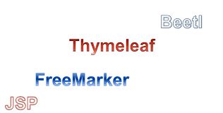

Different Types of View Layers
There are different types of View Layers in Spring Boot for MVC Model. They are:
JSP and JSTL
HTML-5
Velocity and Free Marker
React JS
Angular
Thyme Leaf
DO NOT WRITE ANYTHING
HERE. LEAVE THIS SPACE FOR
WEBCAM

Slide 8

Thyme Leaf Introduction

Slide 9
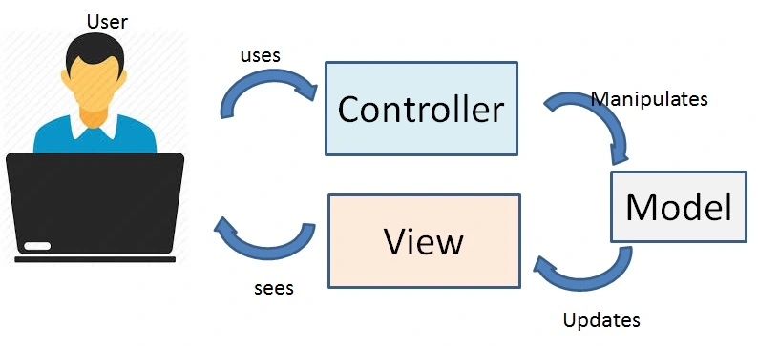


Introduction to Thyme Leaf
Thyme leaf is a Java template engine. It develops templates for both web and standalone applications. This template engine uses the Natural Templates concept to inject logic into your layout, without compromising your design. With Thyme leaf, you’ll have control over how an application will process the templates that you create.
DO NOT WRITE ANYTHING
HERE. LEAVE THIS SPACE FOR
WEBCAM

Slide 10

Introduction to Thyme Leaf
Thyme leaf is a Java XML/XHTML/HTML5 Template Engine that can work both in web (Servlet-based) and non-web environments.
It is better suited for serving XHTML/HTML5 at the view layer of MVC-based web applications, but it can process any XML file even in offline environments.
It provides full Spring Framework integration.
DO NOT WRITE ANYTHING
HERE. LEAVE THIS SPACE FOR
WEBCAM

Slide 11

Features of Thyme Leaf
It works on both web and non-web environments.
Java template engine for HTML5/ XML/ XHTML.
Its high-performance parsed template cache reduces I/O to the minimum.
It can be used as a template engine framework if required.
It supports several template modes: XML, XHTML, and HTML5.
It allows developers to extend and create custom dialect.
It is based on modular features sets called dialects.
It supports internationalization.
DO NOT WRITE ANYTHING
HERE. LEAVE THIS SPACE FOR
WEBCAM

Slide 12



Thyme Leaf Expressions
These can be of five types:
${...} : Variable expressions.
*{...} : Selection expressions.
#{...} : Message expressions.
@{...} : Link (URL) expressions.
~{...} : Fragment expressions.
You can identify when these standard dialects are being used in a template because it will contain attributes starting with the th prefix, like <span th:text="...">.

Slide 13
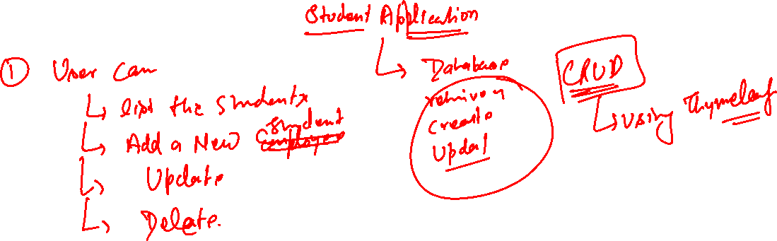


Slide 14
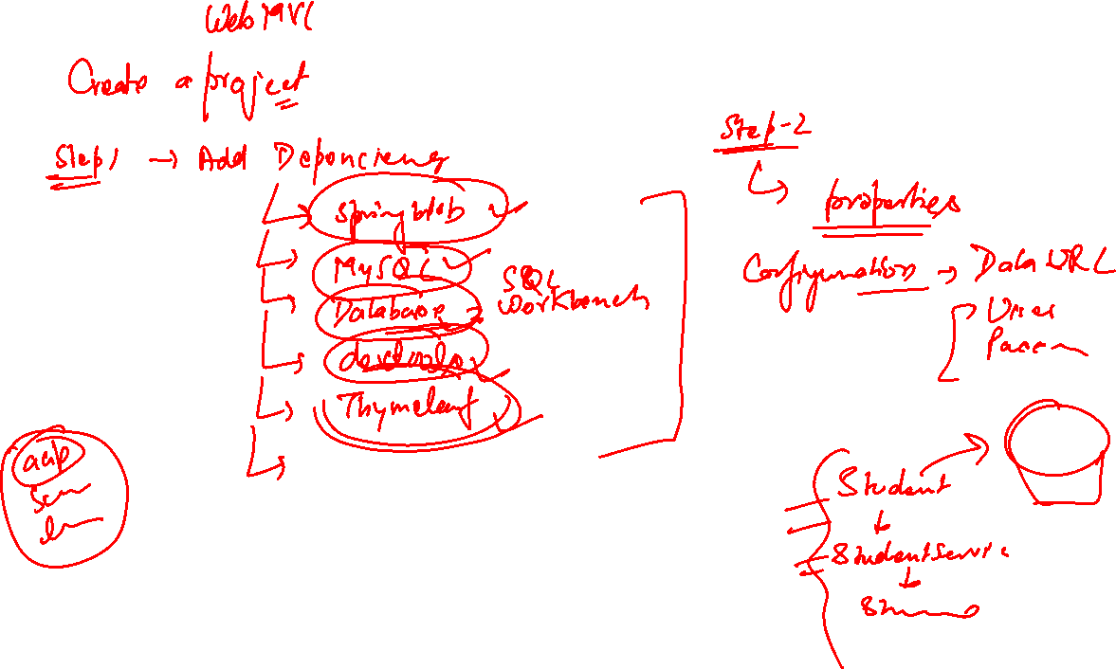

Slide 15
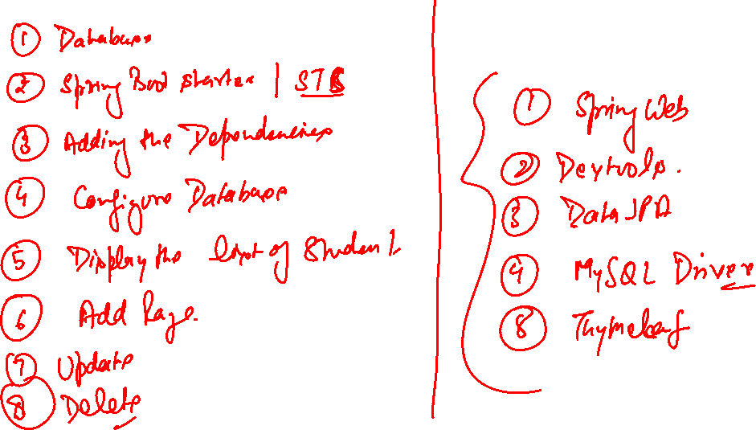

Slide 16
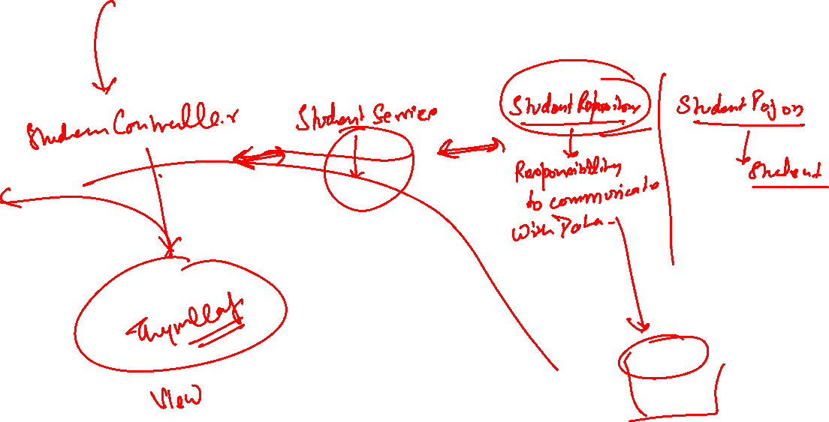

Slide 17
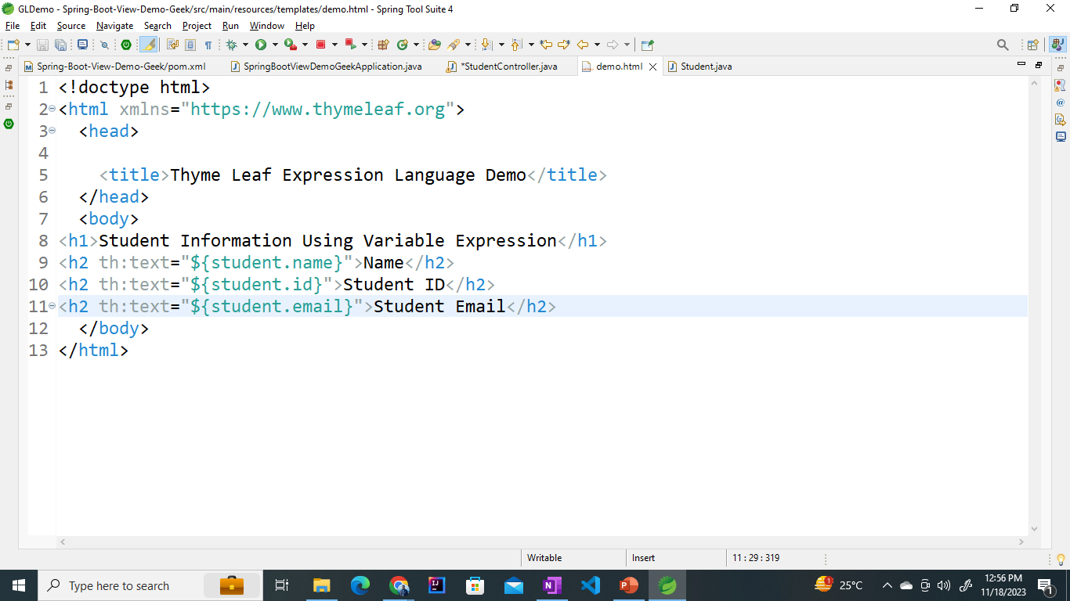
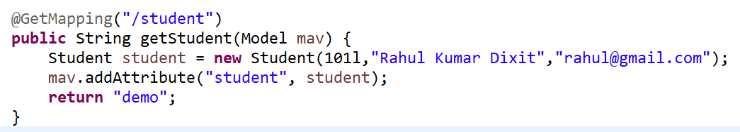

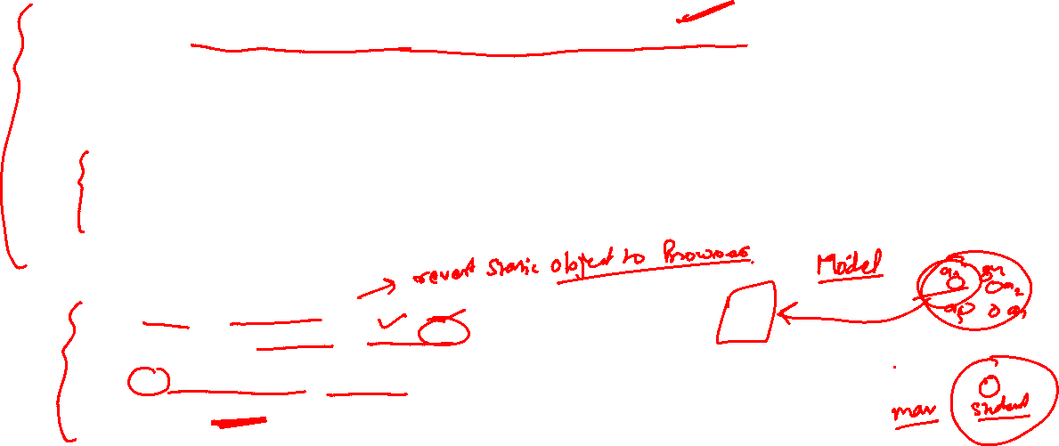
${...} : Variable expressions.
Used to read Object value.

Slide 18

*{...} : Selection expressions.
Selection expressions are just like variable expressions, except they will be executed on a previously selected object instead of the whole context variables map. They look like this:
*{customer.name}
TO read the attributes of and Object
The Scope of the Object is inside the tag only.
We can reuse the same object multiple time in different tag

Slide 19

*{...} : Selection expressions.
The object they act on is specified by a th:object attribute:
<div th:object="${book}">
...
<span th:text="*{title}">
...
</span>
...
</div>

Slide 20





#{...} : Message expressions.
Message expressions allows us to retrieve locale-specific messages from external sources (.properties files), referencing them by a key and (optionally) applying a set of parameters.
Read messages from properties file.
<h1 th:text = "#{demo.hi}"> Message </h1>
messages.properties
demo.hi=Hello This Heading Is Coming From Messages.Properties
Application.properties
spring.messages.basename=messages

Slide 21
Message not working properly
//Create this Bean is Used to Set Default Encoding
@Bean
public MessageSource messageSource() {
ReloadableResourceBundleMessageSource messageSource = new ReloadableResourceBundleMessageSource();
messageSource.setBasenames("classpath:/messages");
messageSource.setDefaultEncoding("UTF-8");
return messageSource;
}
Application.properties
spring.messages.basename=messages

Slide 22
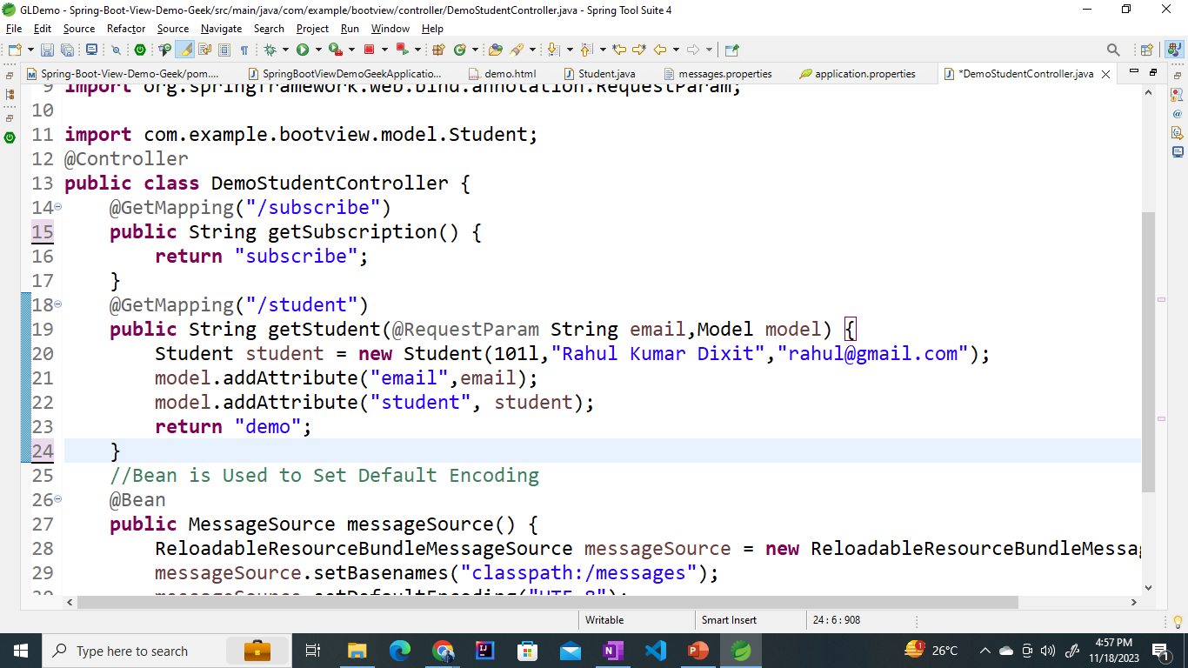
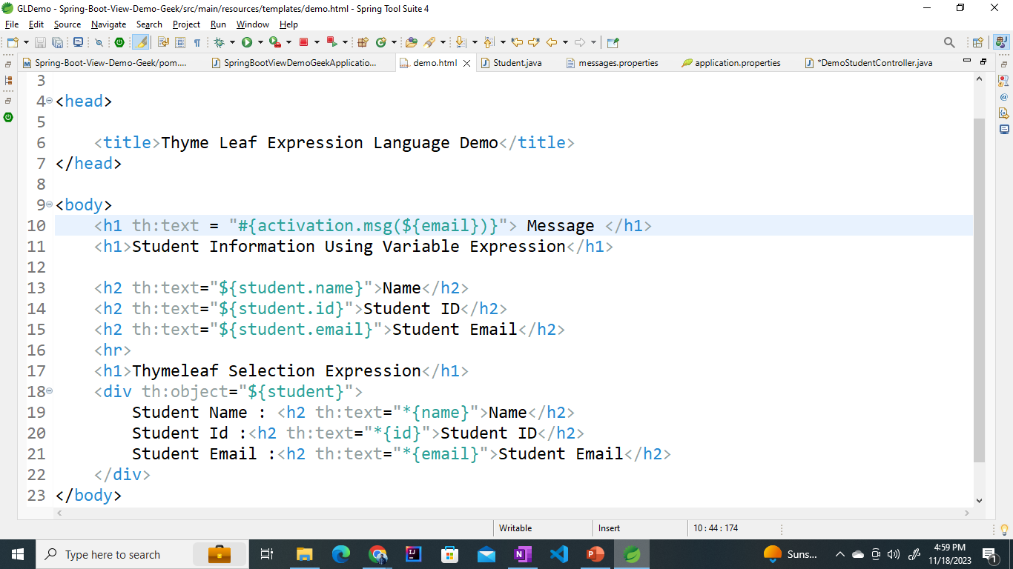
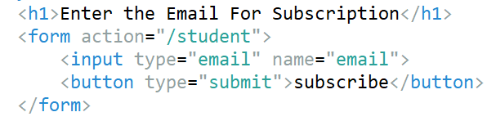
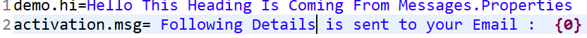
#{...} : Message expressions.
Read Messages from properties file and replace the place holder with value passed by user

Slide 23
@{...} : Link (URL) expressions.
Link expressions are meant to build URLs and add useful context and session info to them :
<a th:href="@{/order/list}">...</a>
URLs can also take parameters:
<a th:href="@{/order/details(id=${orderId},type=${orderType})}">...</a>

Slide 24
Steps to Create Project
Create database using mySql – rahuldb
Create Project Using Spring Starter Web | Spring Initializer
Add Required Dependencies
Configure Data Base Using application.properties

Slide 25
Dependency
To Communicate with Data Base
<dependency>
<groupId>org.springframework.boot</groupId>
<artifactId>spring-boot-starter-data-jpa</artifactId>
</dependency>
=======================================================================================
To Develop Web MVC | Rest Api
<dependency>
<groupId>org.springframework.boot</groupId>
<artifactId>spring-boot-starter-web</artifactId>
</dependency>
=======================================================================================
To Increase the productivity of Developer
<dependency>
<groupId>org.springframework.boot</groupId>
<artifactId>spring-boot-devtools</artifactId>
<scope>runtime</scope>
<optional>true</optional>
</dependency>

Slide 26
Thymeleaf
<dependency>
<groupId>org.springframework.boot</groupId>
<artifactId>spring-boot-starter-thymeleaf</artifactId>
</dependency>
=======================================================
MYSql Connector
<groupId>mysql</groupId>
<artifactId>mysql-connector-java</artifactId>
<scope>runtime</scope>
</dependency>

Slide 27
Database Configuration
spring.datasource.url=jdbc:mysql://localhost:3308/rahuldb
spring.datasource.username=root
spring.datasource.password=ROOT
spring.jpa.hibernate.ddl-auto=update

Slide 28

5 min break
This a 5 min break for you
Have a glass of water
Take a deep breath
Note down any doubt you have till now
Join back
DO NOT WRITE ANYTHING
HERE. LEAVE THIS SPACE FOR
WEBCAM

Slide 29
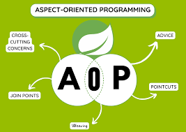
Introduction to AOP

Slide 30

Introduction to AOP
Aspect oriented programming(AOP) as the name suggests uses aspects in programming.
It can be defined as the breaking of code into different modules, also known as modularization, where the aspect is the key unit of modularity.
Aspects enable the implementation of crosscutting concerns such as- transaction, logging not central to business logic without cluttering the code core to its functionality.
It does so by adding additional behavior that is the advice to the existing code.
For example- Security is a crosscutting concern, in many methods in an application security rules can be applied, therefore repeating the code at every method, define the functionality in a common class and control were to apply that functionality in the whole application.
DO NOT WRITE ANYTHING
HERE. LEAVE THIS SPACE FOR
WEBCAM

Slide 31
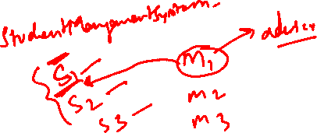
Dominant Frameworks of AOP
AOP includes programming methods and frameworks on which modularization of code is supported and implemented. Let’s have a look at the three dominant frameworks in AOP:
AspectJ: It is an extension for Java programming created at PARC research center. It uses Java like syntax and included IDE integrations for displaying crosscutting structure. It has its own compiler and weaver, on using it enables the use of full AspectJ language.
JBoss: It is an open source Java application server developed by JBoss, used for Java development.
Spring: It uses XML based configuration for implementing AOP, also it uses annotations which are interpreted by using a library supplied by AspectJ for parsing and matching.
DO NOT WRITE ANYTHING
HERE. LEAVE THIS SPACE FOR
WEBCAM

Slide 32
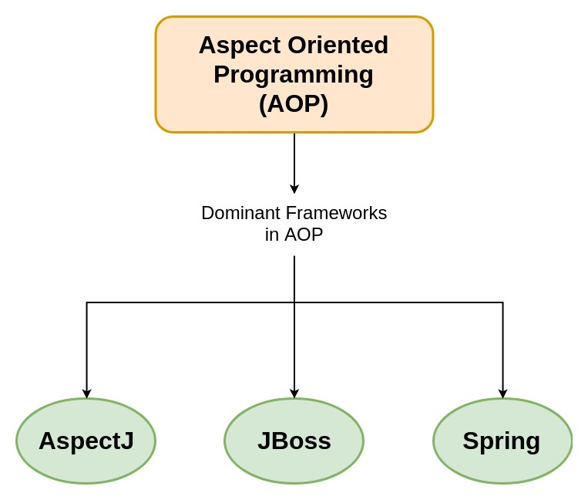

Dominant Frameworks of AOP
AOP includes programming methods and frameworks on which modularization of code is supported and implemented. Let’s have a look at the three dominant frameworks in AOP:
DO NOT WRITE ANYTHING
HERE. LEAVE THIS SPACE FOR
WEBCAM

Slide 33
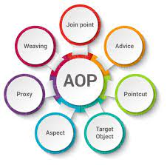
Common Entities of AOP
Aspect: The class which implements the JEE application cross-cutting concerns(transaction, logger etc) is known as the aspect. It can be normal class configured through XML configuration or through regular classes annotated with @Aspect.
Weaving: The process of linking Aspects with an Advised Object. It can be done at load time, compile time or at runtime time. Spring AOP does weaving at runtime.
Let’s write our first aspect class but before that have a look at the jars required and the Bean configuration file for AOP.
DO NOT WRITE ANYTHING
HERE. LEAVE THIS SPACE FOR
WEBCAM

Slide 34
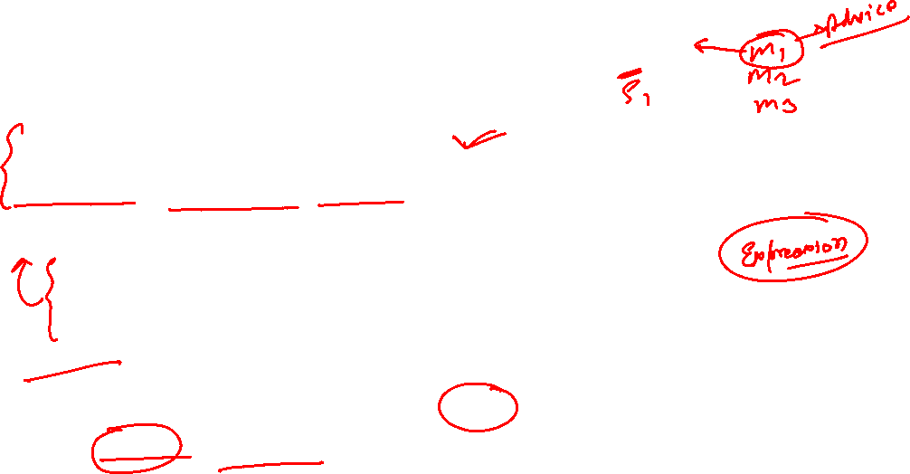
Understanding AOP Terminology
Compile Time:
Advice:- What code to Execute
Pointcut:- Expression that identifies method call to be intercept.
Aspect:- A combination of
Advice : What to do
Pointcut : when to intercept a method call
Weaver:-
Is a framework that implements AOP.
AspectJ & Spring AOP is a good example of weaver

Slide 35

Understanding AOP Terminology
Run Time:
Join Point :- when pointcut condition is true, the advice is executed. A specific execution instance of advice is called a joinpoint.

Slide 36
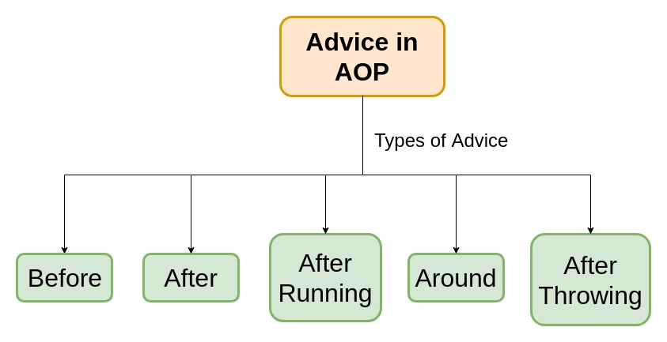
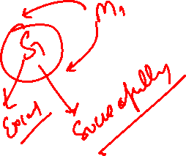
Common Entities of AOP
Advice: The job which is meant to be done by an Aspect or it can be defined as the action taken by the Aspect at a particular point. There are five types of Advice namely: Before, After, Around, After Throwing and After Returning. Let’s have a brief discussion about all the five types.
DO NOT WRITE ANYTHING
HERE. LEAVE THIS SPACE FOR
WEBCAM

Slide 37

Dependency
<dependency>
<groupId>org.springframework.boot</groupId>
<artifactId>spring-boot-starter-aop</artifactId>
</dependency>

Slide 38
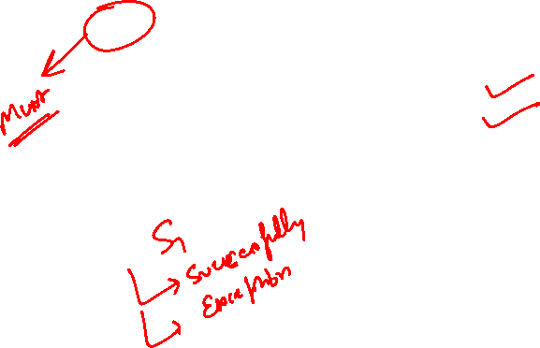
Types of Advices- AOP
Before: Runs before the advised method is invoked. It is denoted by @Before annotation.
After: Runs after the advised method completes regardless of the outcome, whether successful or not. It is denoted by @After annotation.
1. Method Executes Successfully
2. Method throws an Exception
DO NOT WRITE ANYTHING
HERE. LEAVE THIS SPACE FOR
WEBCAM

Slide 39
Creating Logging Aspect
Compile Time :
//execution (* package.*.*.*(..))“ [where to execute]
//Advice : What code is executed
//Point Cut Expression that identifies method call to be intercepted
@Configuration
@Aspect [A Combination of 1: Advice & 2: Pointcut ][what to do & When to do]
public class LoggingAspect {
private Logger logger = LoggerFactory.getLogger(getClass());
//Before : Example
@Before("execution (* package.*.*.*(..))")
public void logMethodBeforeCall(JoinPoint joinpoint ) {
logger.info("Before Method is Called - {}",joinpoint);
}
}

Slide 40
Runtime :
Join Point : When Point Cut Condition is true ,The Advice is executed . A Specific Execution instance of advice is called a join point.

Slide 41
Types of Advices- AOP
AfterThrowing: Runs after the advised method throws a Runtime Exception. It is denoted by @AfterThrowing annotation.
@AfterThrowing(
pointcut = "execution(* Package.*.*.*(..))",
throwing = "exception"
)
public void logMethodCallAfterException(JoinPoint joinPoint, Exception exception) {
logger.info("AfterThrowing Aspect - {} has thrown an exception {}"
, joinPoint, exception);
}
DO NOT WRITE ANYTHING
HERE. LEAVE THIS SPACE FOR
WEBCAM

Slide 42
Types of Advices- AOP
After Returning: Runs after the advised method successfully completes ie without any runtime exceptions. It is denoted by @AfterReturning annotation.
@AfterReturning(
pointcut = "execution(* package.*.*.*(..))",
returning = "resultValue"
)
public void logMethodCallAfterSuccessfulExecution(JoinPoint joinPoint,
Object resultValue) {
logger.info("AfterReturning Aspect - {} has returned {}"
, joinPoint, resultValue);
}
DO NOT WRITE ANYTHING
HERE. LEAVE THIS SPACE FOR
WEBCAM

Slide 43
Types of Advices- AOP
Around: This is the strongest advice among all the advice since it wraps around and runs before and after the advised method. This type of advice is used where we need frequent access to a method or database like- caching. It is denoted by @Around annotation.
@Around("execution (* package.*.*.*(..))")
// ProceedingJoinPoint : used to Proceed the method
public Object findExecutionTime(ProceedingJoinPoint proceedingJoinPoint) throws Throwable {
//Start a timer
long startTimeMillis = System.currentTimeMillis();
//Execute the method
Object returnValue = proceedingJoinPoint.proceed();
//Stop the timer
long stopTimeMillis = System.currentTimeMillis();
long executionDuration = stopTimeMillis - startTimeMillis;
logger.info("Around Aspect - {} Method executed in {} ms"
,proceedingJoinPoint, executionDuration);
return returnValue;
}
DO NOT WRITE ANYTHING
HERE. LEAVE THIS SPACE FOR
WEBCAM

Slide 44
Creating Common PointCut
Point Cut Defined in Some Common Class : CommonPointcutConfig
@Pointcut("execution (* package.*.*.*(..))")
public void businessAndDataPackageConfig() {}
=================================
Applying on existing :
@Before(“package. CommonPointcutConfig.businessAndDataPackageConfig()")
public void logMethodBeforeCall(JoinPoint joinpoint ) {
logger.info("Before Method is Called - {} with following argument {}"
,joinpoint,joinpoint.getArgs());
}

Slide 45

Logging in Spring Boot

Slide 46


Any doubts?

Slide 47

Summary
In this session we have learnt,
Introduction to MVC
View Layer and its Roles
Different Types of View Layers
Introduction to Thyme Leaf
Features of Thyme Leaf
Thyme Leaf Templates
Introduction to AOP
Frameworks of AOP
Components of AOP
Logging and its configuration
DO NOT WRITE ANYTHING
HERE. LEAVE THIS SPACE FOR
WEBCAM

Slide 48












